Slide 1
R and SQL

Slide 2
R in SQL SERVER
Microsoft Machine Learning R Server
Microsoft R Client
Microsoft R Open
R Tools for Visual Studio

Slide 3
Microsoft R Open
Microsoft R Open is an open source R distribution that is 100% free and generally available
R Open is also compatible with the CRAN repository
memory bound
an additional high-performance multi-threaded feature

Slide 4
Microsoft R Client
ScaleR functions
Memory bound
processing will be limited to only two threads simultaneously

Slide 5
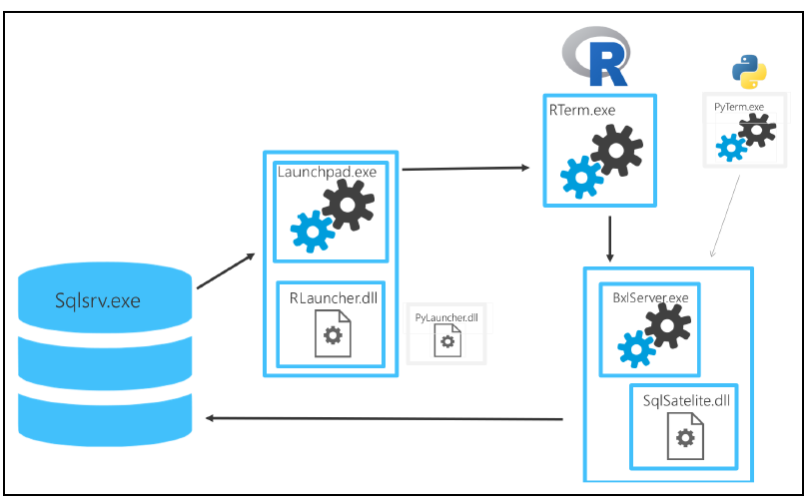
Microsoft SQL Server Machine Learning R Services
covers all the ScaleR algorithms
R execution is done using the SQL Server Trusted Launchpad service

Slide 6
Enabling services
EXEC sp_configure 'show advanced options',1;
GO
RECONFIGURE;
GO
EXEC sp_configure 'external scripts enabled';
GO
EXEC sp_configure 'external scripts enabled', 1;
GO
RECONFIGURE WITH OVERRIDE;
GO

Slide 7
Runing R
EXEC sp_execute_external_script
@language = N'R'
,@script = N'OutputDataSet<- InputDataSet'
,@input_data_1 = N'SELECT 1 AS Numb UNION ALL SELECT 2;'
WITH RESULT SETS
((
Res INT
));
GO

Slide 8
Installing new packages - 1
Packages are always saved in the library folder but, depending on your version of R
-- Path to libraries on your computer/server
EXECUTE sp_execute_external_script
@language = N'R'
,@script = N'OutputDataSet <- data.frame(.libPaths());'
WITH RESULT SETS (([DefaultLibraryName] VARCHAR(MAX) NOT NULL));
GO

Slide 9
Installing new packages - 2
To install the package in the R Server folder, you need to have administrator-level access
install.packages("dplyr", dependencies = TRUE, lib = "C:/Program Files/Microsoft SQL Server/MSSQL14.MSSQL2017/R_SERVICES/library")
LIB can be different on your computer

Slide 10
sp_execute_external_script external procedure - 1
sp_execute_external_script
@language = N''
,@script = N'',
,@input_data_1 = 'input_data_1'
,@input_data_1_name = N'input_data_1_name'
,@output_data_1_name = 'output_data_1_name'
,@parallel = 0 | 1
,@params = N''
,@parameter1 = ''

Slide 11
sp_execute_external_script external procedure – 2
@input_data_1: takes your T-SQL code as the source of data. NVARCHAR
SELECT
SELECT with multiple JOINS
WITHcommontable expressions
UNION, UNIONALL, EXCEPT, INTERSECT
Any SET, STRING, LOGICAL, COMPARISON, BITWISE, ARITHMETIC, COMPOUND
operators
COLLATE

Slide 12
sp_execute_external_script external procedure – 3
@input_data_1_name: holds the name of the dataset that will be used in the R script as an input dataset
By default, the external procedure sp_execute_external_script will be using the following:-InputDataSet for inputting data and-OutputDataSet for returning result data

Slide 13
sp_execute_external_script external procedure – 4
@output_data_1_name: holds the definition of the returned result from an external script as a variable returned to any stored procedure. The returned dataset must be in the data.frame format in the R language
@params: an argument where any additional variable can be declared and specified as a variable(s) that can be used in the R script
@parameter1: an argument where the values of the parameters are specified and used within the R script in the form of an input or output variable

